Slide 1


Cloud-based Multi-Agent
Framework for Solo-Founders
Pre Seed: 2026
AI Agents that work while you sleep.
yarnnn.com · Kevin Kim · seulkim88@gmail.com

Slide 2
It looks like the big players will own everything.
Claude has coding agents, desktop, cowork.
ChatGPT has memory, Codex, Sora.
The market assumes they'll consume every layer.
But every platform cycle looks that way — until it doesn't.
Google didn't become Salesforce.
Facebook didn't become Shopify.
AWS didn't become Datadog.

Slide 3
The Honest Bet
History never repeats, but it does rhyme.
Our thesis is that even with the AI tech revolution,
the application layer is yet to come.
2008: Google
→
Looked like it would own everything on the web. It didn't become Salesforce.
2012: Facebook
→
Looked like it would own all of social commerce. It didn't become Shopify.
2015: AWS
→
Looked like it would own every cloud application. It didn't become Datadog.
2026: LLMs
→
Look like they'll own every layer. But code was the easy case. Work context is the hard one.
The application layer of the AI platform shift is yet to come, and we're taking the bold bet that it will be Agent-native, and the work economy will shift from human → agents

Slide 4
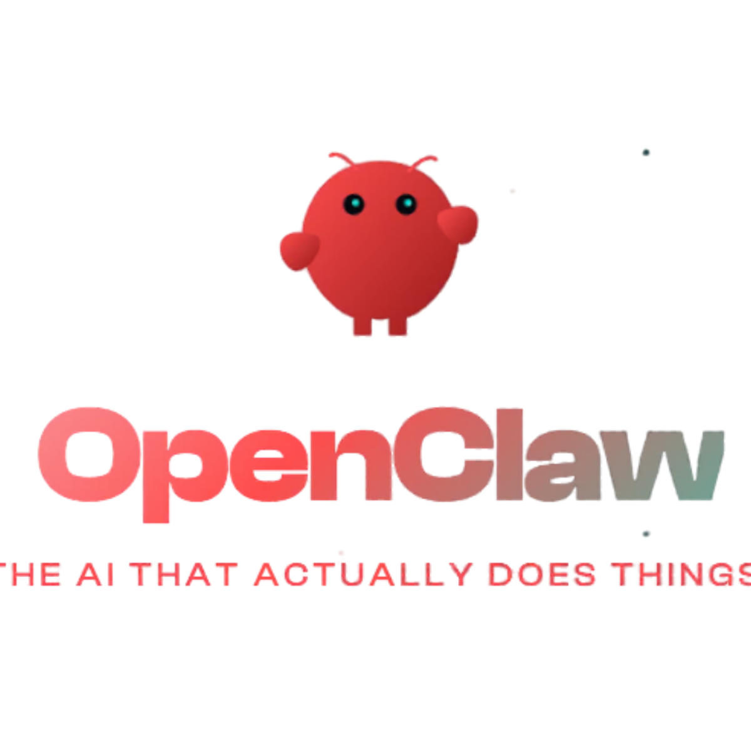
Proof of Demand
OpenClaw proved the appetite is real.
17,830
But 95% of people
can't use it.
GitHub stars in 24 hours
High technical barrier, privacy, hardware setup
Fastest single-day growth in GitHub history.
"The first time I've felt like I'm living in the future since ChatGPT launched."
— ClawdBot user
✘
Requires VPS provisioning (only 5% can do this)
✘
200+ security leaks detected (GitGuardian)
✘
No project isolation or recurring workflows

Slide 5
Product
Architecture
Solution / Moat

Slide 6
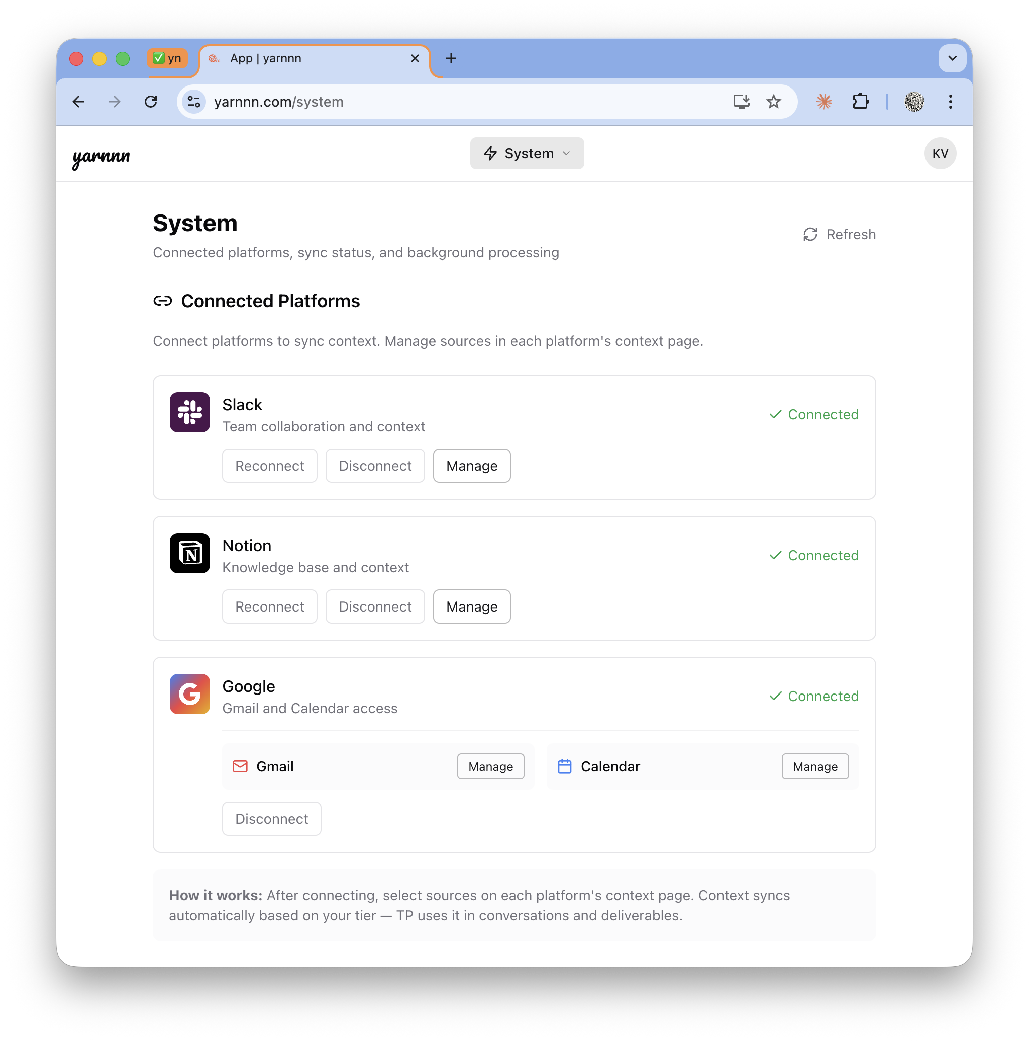
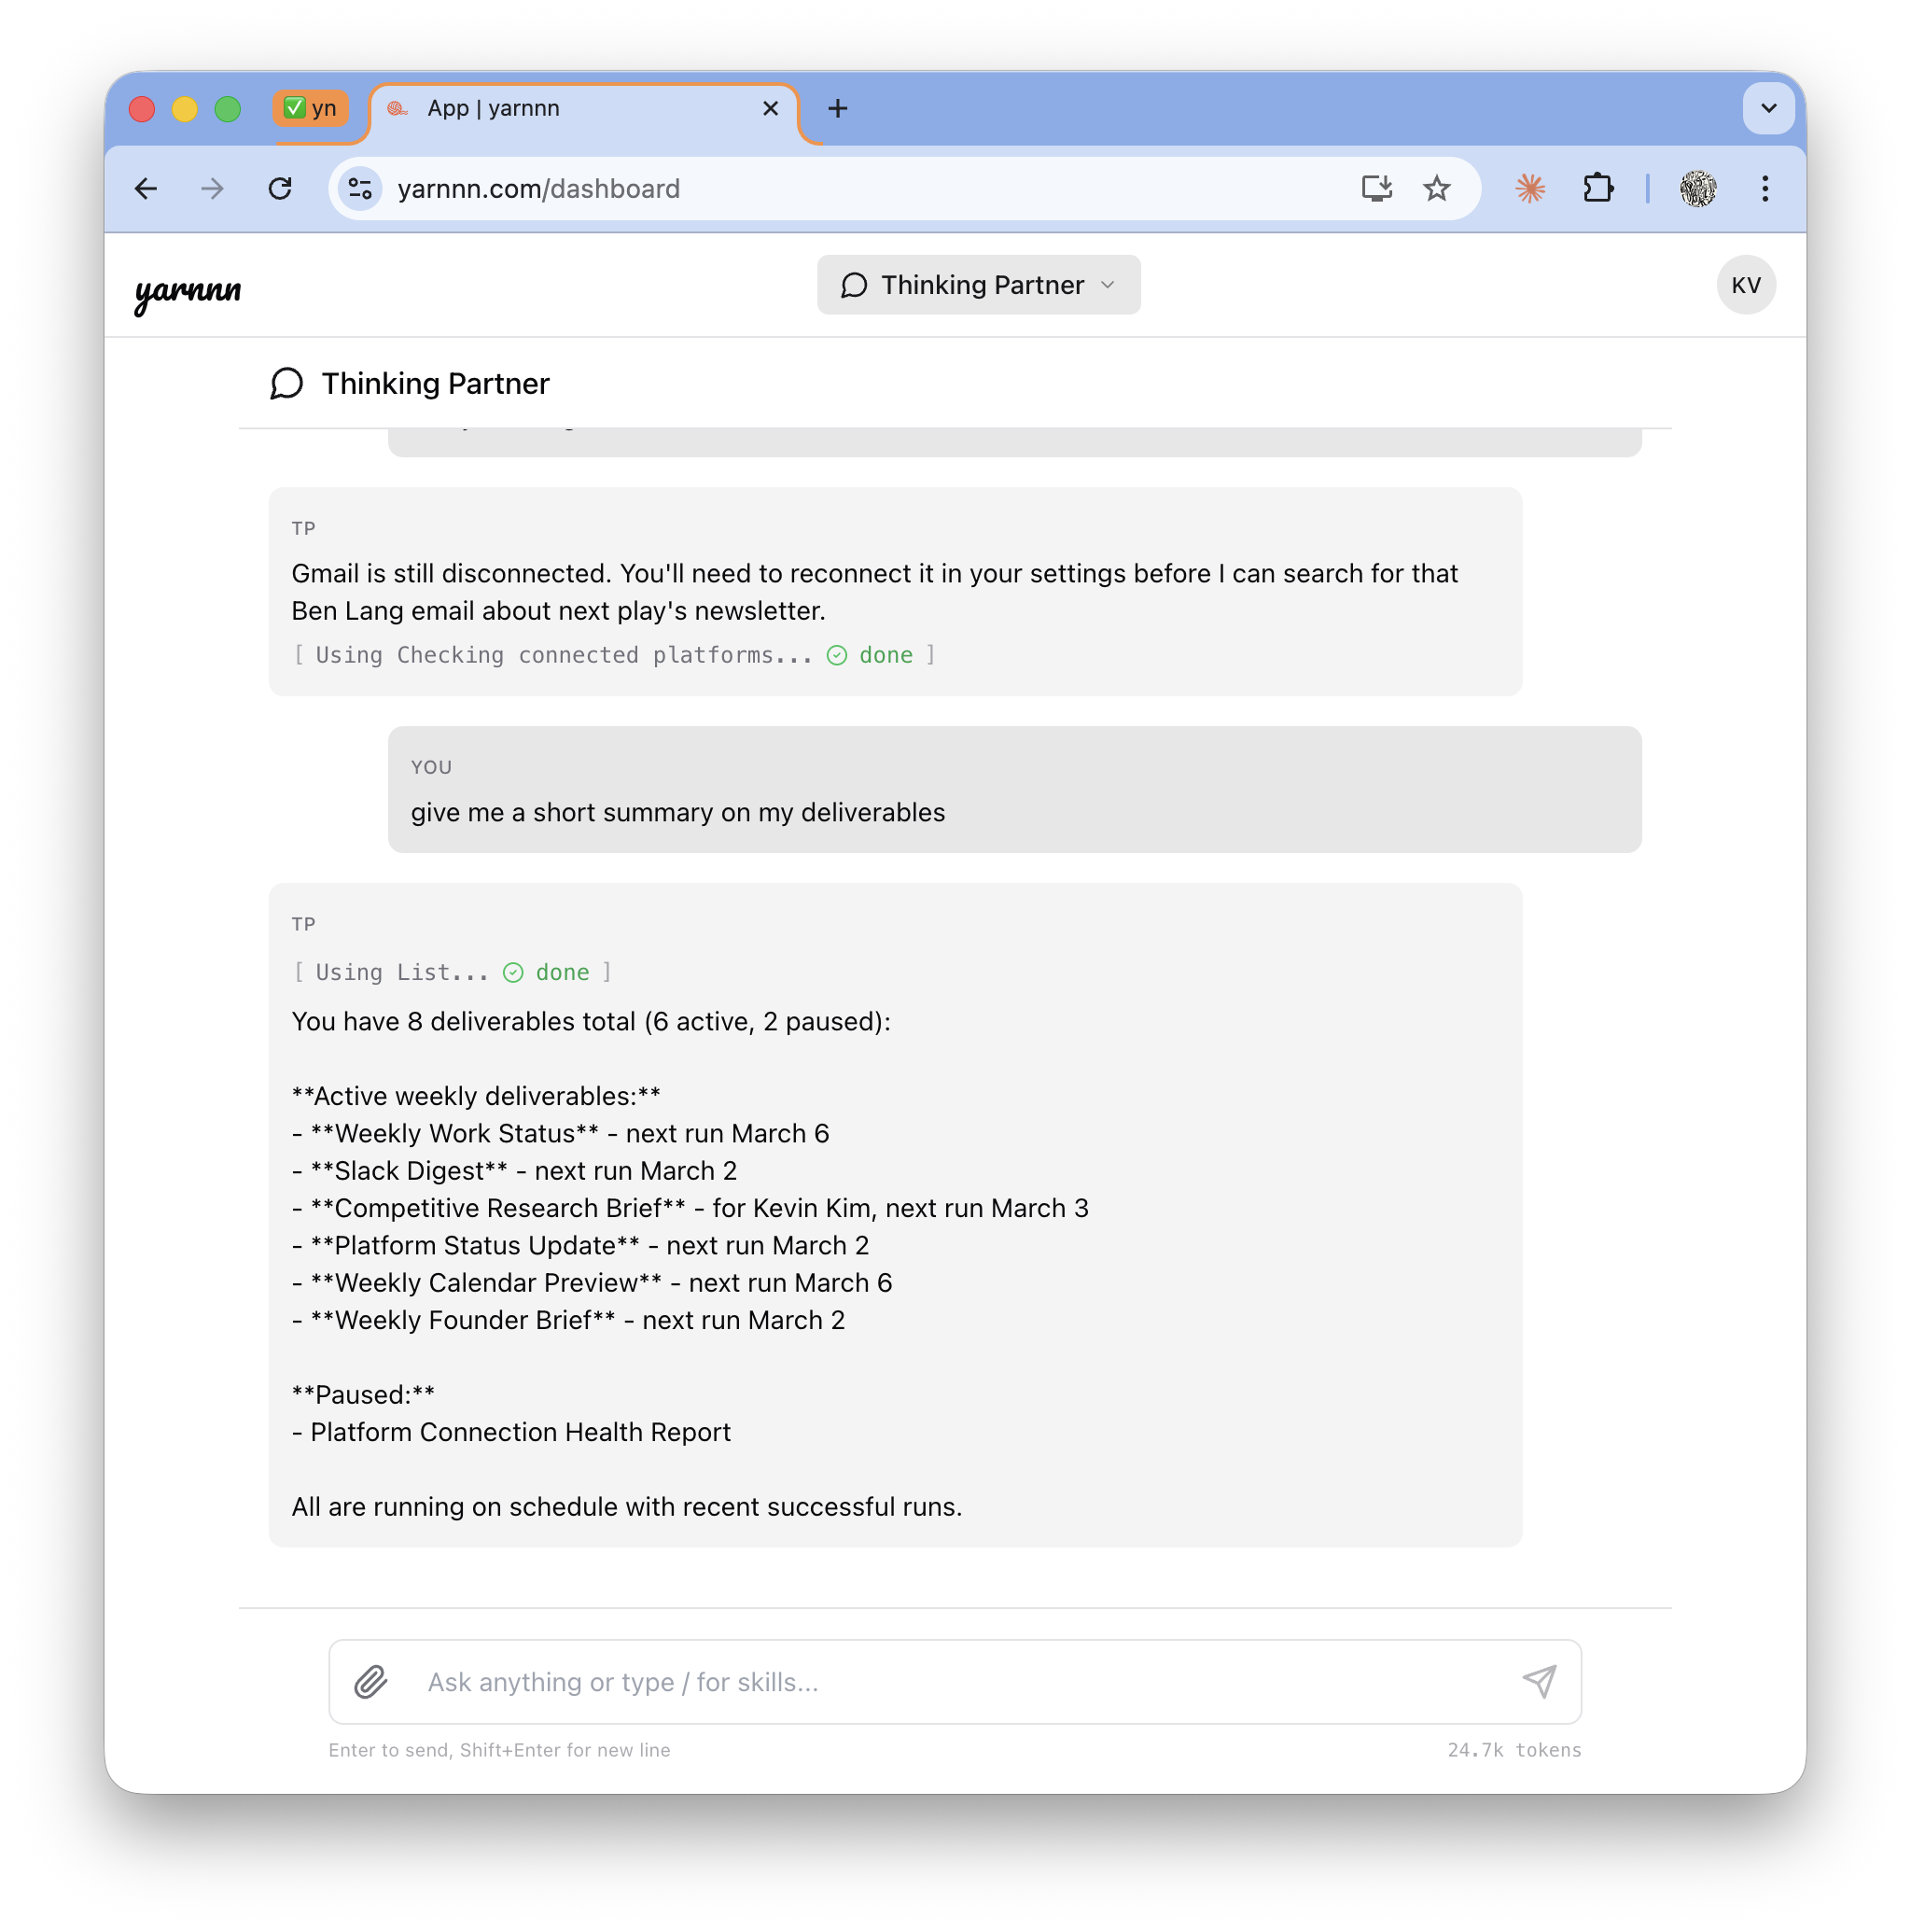
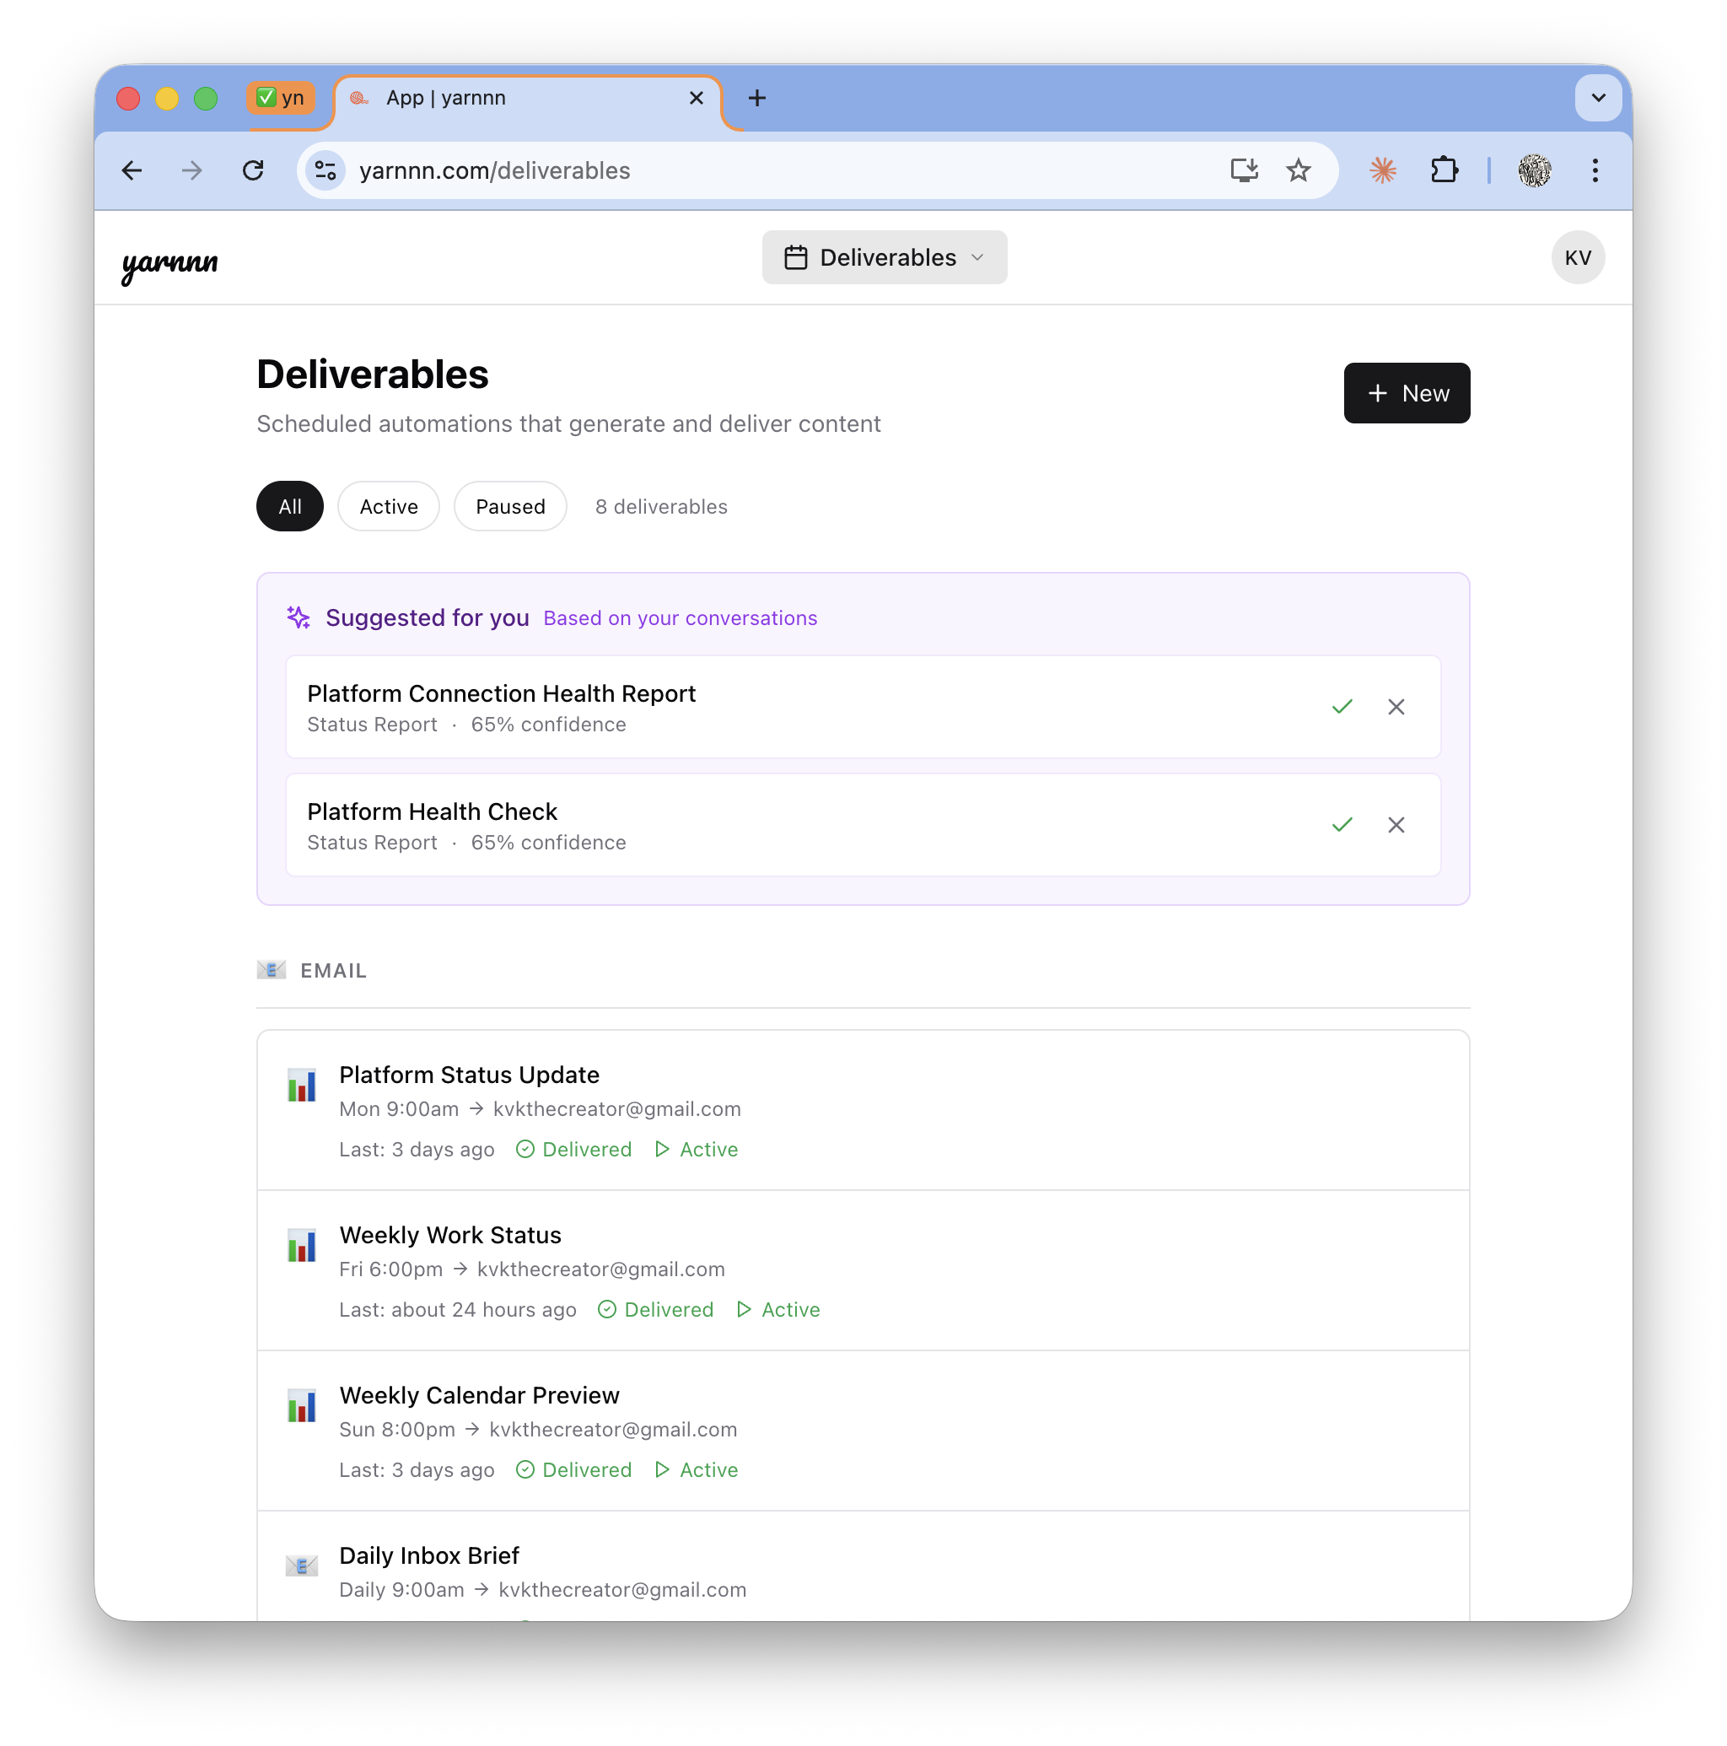
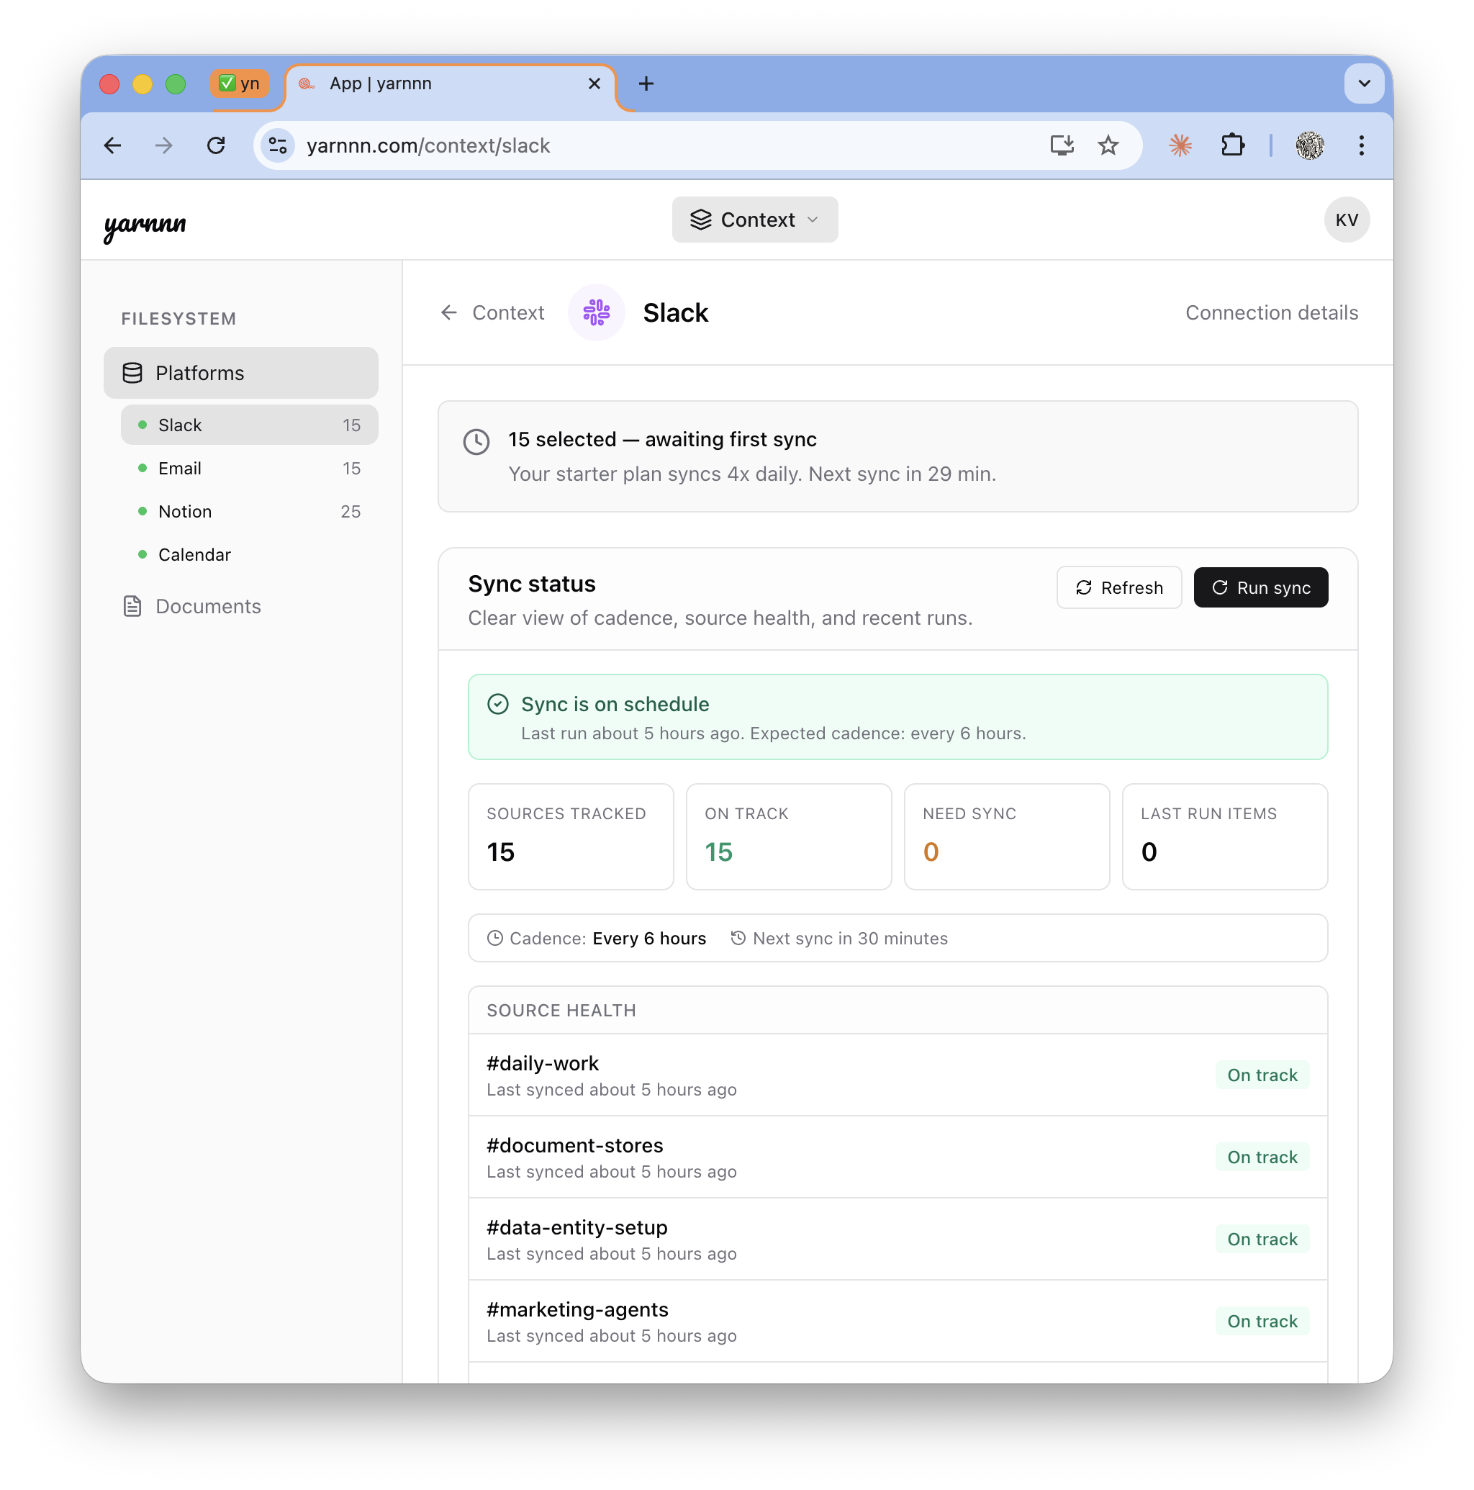
Product: Meet yarnnn's Agent Framework
Multi-Agent Framework. Just setup and work
T+0s
T+30s
Days
Weeks
Dump, Connect
Agent Setup
Accumulate
Compound
Tell us what you're working on. System extracts work scopes. No configuration.
Projects auto-created with Agent scaffolding, context loading, work boundary creations
Every sync deepens knowledge. Every edit refines quality. Teams coordinate.
PM coordination matures. Cross-phase handoffs refine. Output quality compounds.

Slide 7
Agent Architecture and Orchestration
Built for coordinated, autonomous team execution
Every purpose-built layer compounds — creating recursive feedback between agent output and delivery
Perception
Pipeline
Knowledge
Base
Workspace
Filesystem
Agent
Teams
Output
Gateway
Slack
Notion
Unified content
Retention + provenance
Charter + memory
Agent workspaces
8 types, PM dispatch
3-tier pulse
HTML compose
PDF · PPTX · XLSX
Why this can't be bolted on:
Big Players, LLM Providers
Agent Startups
Workspace AI
No value chain from description to compounding.
Each session isolated. No team coordination.
Can execute but can't accumulate.
No Phases 5-7 (compounding).
Every run starts fresh.
Trapped in one platform. Can't compose
cross-platform agent teams.
No recursive perception.

Slide 8
Product
Pick what you want delivered.
13 task types across 5 categories. Each one is a concrete deliverable with a pre-built multi-agent pipeline behind it.
Category
Deliverable
Pipeline (agents)
Default cadence
INTELLIGENCE
Competitive Intel Brief
Research → Content
Weekly
Market Research Report
Research → Content
Monthly
Industry Signal Monitor
Marketing → Research
Weekly
OPERATIONS
Meeting Prep Brief
CRM → Research
On-demand
Stakeholder Update
Research → Content
Monthly
Project Status Report
Slack → CRM → Content
Weekly
PLATFORM
Slack Recap
Slack Bot
Daily
Notion Sync Report
Notion Bot
Weekly
CONTENT
Content Brief / Blog Draft
Research → Content
On-demand
Launch Material
Marketing → Content
On-demand
TRACKING
GTM Tracker
Marketing → Content
Weekly
Users pick deliverables, not agents. Each task type has a pre-meditated pipeline — deterministic, predictable cost, no runtime orchestration overhead. Custom tasks use improvised TP orchestration.

Slide 9
Product
8 Agent Types. Each one hired for a job.
Deterministic (close-to) agent configurations, with individual memory, self-assessment, and collaboration
Briefer
Monitor
Researcher
Analyst
Recurring digests from platform activity. Your daily pulse on what happened.
Watches for changes and patterns. Alerts on what matters, ignores what doesn't.
Deep dives with web search. Finds context beyond your connected platforms.
Cross-references sources. Surfaces patterns humans miss across platforms.
Drafter
Writer
Planner
Scout
Produces first drafts from briefs. Turns PM instructions into starting points.
Polished final output. Blog posts, reports, memos that ship as-is.
Roadmaps, strategies, structured plans. Turns goals into actionable sequences.
Tracks competitors and market signals. Watches the outside while you work inside.
Project Manager Agent
Coordinates contributor phases, quality-gates assembly, steers the team.
One per project.

Slide 10
Product
From Context to Autonomous Delivery
Each phase feeds the next. The system compounds — competitors starting fresh can't catch up.
Context
Inference
Task Type Selection
Pipeline Execution
Autonomous Delivery
Connect Slack + Notion. Content syncs and accumulates over time.
▶
System reads your work. Extracts identity, brand, scopes from docs + chat.
▶
Pick deliverables from the catalog. Each has a pre-built pipeline.
▶
Multi-agent pipeline runs mechanically. Each step hands off to the next.
▶
Output compounds weekly. Feedback refines agents. Quality improves with use.
What makes our architecture unique:
Pre-meditated pipelines
Filesystem IS the architecture
Knowledge compounds, not resets
Each task type carries a defined execution plan. Agents run in sequence with explicit handoffs. Deterministic cost (~$0.06–$0.16/run). No runtime AI orchestration needed.
TASK.md + AGENT.md define everything. No hidden state. Agents read the same files humans can edit. Workspace accumulates — every run adds to the knowledge substrate.
Every sync deepens context. Every edit trains preferences. 90 days of accumulated intelligence can't be replicated by starting over. Switching cost is structural.

Slide 11
Solution: Moat
Team Intelligence Compounds. Switching Costs Follow.
Every agent run makes the next one better. Every edit teaches the team. Every sync deepens knowledge.
Three moat mechanics:
Describe
1
Accumulation: Every iteration cycle deepens cross-platform understanding. Agent teams don't start from zero.
Compounding
Team
Intelligence
2
Coordination: PM learns which phases work, which handoffs succeed. Team intelligence compounds independently of individual agent improvement.
Supervise
Accumulate
3
Irreversibility: 90 days of accumulated team intelligence — agent memory, PM patterns, learned preferences — can't be replicated
Coordinate

Slide 12
Positioning • Market •
Competitive Landscape

Slide 13
Positioning
Not another chatbot. Not another agent framework.
Only platform where coordinated agent teams accumulate cross-platform work knowledge for autonomous output.
Autonomy
 | yarnnn | Big-Players ChatGPT /Claude | Agent Startups Mem.ai, Genspark | Workspaces Notion, Slack
Coordinated agent teams | ✓ | ✘ | ✘ | ✘
Cross-platform knowledge | ✓ Evolving | ✘ | ✘ | Single
Cross-platform sync | ✓ | ✘ | ✘ | ✘
Autonomous output | ✓ Scheduled | ✘ | ✓ | ✘
Improves with tenure | ✓ Accumulation | Evolving | ✘ | ✘
PM team coordination | ✓ | ✘ | ✘ | ✘
yarnnn
ChatGPT
Claude Cowork /
Genspark
Knowledge
Accumulation
Existing
Workspaces
Agent-based
Startups

Slide 14
Market
Starting with solo consultants. Expanding from there.
Entry wedge: Solo consultants with recurring client obligations
TAM
SAM
Entry SOM
$4.35B
$1.14B
$4.6M
AI productivity tools market (31% CAGR)
~5M solo consultants globally × $228/yr (Pro annual)
20K consultants in first 3 years
Expansion path:
Now
Solo consultants
Recurring reports, clear pain, willing to pay
Next
Founders & executives
Investor updates, board prep, strategic briefs
Then
Teams & ops leads
Standups, project reports, cross-team synthesis
Scale
All knowledge workers
Any professional with recurring work obligations

Slide 15
Pricing Model
Two tiers. Work credits are the lever.
Free
Pro
Enterprise
$0
$19
TBD
/mo
/mo
/mo
· 2 active tasks
· 10 active tasks
· Everything in Pro
· 20 work credits / month
· 500 work credits / month
· Team workspaces
· 150 chat messages / month
· Unlimited chat messages
· Priority support
· 5 Slack / 10 Notion sources
· Unlimited sources
· Custom integrations
· Daily sync
· Hourly sync
· Agent-to-agent protocol
Credits: task run = 3 credits, render/export = 1 credit. Multi-step pipelines cost 3 credits per step.
Unit economics: Target 70%+ gross margin at scale. Yearly plan: 2 months free (17% off). Pro $190/yr.

Slide 16
Product Roadmap
Coordinated Agent Teams (shipped) → Cross-Platform Intelligence → Agent Protocol
Each phase deepens the value chain. Shipped work compounds into the next layer of capability.
SHIPPED ✓
NEXT 6-12mo.
VISION +12mo.
Coordinated Agent
Teams
Cross-Platform
Intelligence
Agent-to-Agent
Protocol
Work-first onboarding + project scaffolding
►
Projects: multi-agent assembled deliverables
►
MCP protocol interop. External agents consume yarnnn context
PM phase dispatch + quality gating
Composer-driven assembly from contributions
Agent-to-agent coordination across systems
8 agent types (three-registry)
Deeper platform coverage: 365, Google Drive
Platform play: own the work context graph
Output gateway: HTML compose, PDF, PPTX, XLSX
HTML-native compose as output pipeline
Feedback substrate: edit distillation + self-reflection
Workspace filesystem + cross-agent collaboration
136 Architecture Decision Records

Slide 17
(Pre) Seed - The Ask
$500K at $5M post-money valuation.
Use of funds:
Why now:
Positioning:
→ Tech Lead (memory/ML)
→ ClawdBot: 17,830 stars / 24hrs
→ Application layer still pre-mature
→ GTM Lead (creator community)
→ No one owns the context layer
→ True Agent-native architecture
→ 12 months runway
→ Architecture built, need team
Priority 0: Team-Building
Betting on an agent-first future:
Differentiation:
→ ML engineer for memory extraction
→ LLM readiness moving towards Agents
→ Coordinated teams, not solo agents
→ Community builder for creator GTM
→ Thesis is the work economy will shift
→ Cross-platform, LLM agnostic
→ Seed funds → team of 3
→ 136 ADRs = architectural rigor

Slide 18
yarnnn.com · Kevin Kim · seulkim88@gmail.com

Slide 19
Appendix
Kevin (Seul Ki) Kim
Founder & CEO, KVK Labs (yarnnn)
https://www.linkedin.com/in/kimseulki0727/
B.S. Industrial and Systems Engineering, Virginia Tech
+10 years designing CRM and GTM systems in FMCG.
CMO, CPO positions in Korea based startups, Ran e-commerce fashion brand for 5 years,
Full-stack application for yarnnn, (Next.js + FastAPI + Supabase), two platform integrations,
coordinated agent team architecture with PM phase dispatch, documented across 136
Architecture Decision Records.
Targeting US market; execute GTM and team-building as priority next step.
yarnnn.com · Kevin Kim · seulkim88@gmail.com

Slide 20
Appendix: Value Realization Chain
What the User Experiences: Describe to Compound
Time | What happens | What the user sees
T+0s | User describes work, projects scaffold | "I've set up 3 projects for your client work"
T+30s | Platforms connect, sources mapped to projects | Dashboard: "Slack connected — channels mapped"
T+90s | PM dispatches first contributor runs | First deliverables appear per project
Day 2-7 | Daily pulse cycles, agents accumulate | Deliverables arrive, improving each run
Week 2 | PM coordination matures, phases sequence | Cross-phase handoffs visible in output
Month 1 | Multiple agents running, feedback refining | Agents noticeably tailored to preferences
Month 3 | Composer identifies cross-project opportunities | System understands work deeply
Describe → Scaffold → Connect → First Value → Accumulate → Coordinate → Compound ↻

Slide 21
Appendix: Architecture Depth
What a Well-Funded Team Can't Shortcut
"Claude Code Online" — Output Gateway
PM-Coordinated Phase Dispatch
Same capabilities model as Claude Code (SKILL.md + local tools + filesystem), but persistent, autonomous, and cloud-native. Two-filesystem architecture: capability filesystem (skills on Docker) + content filesystem (workspace per agent). Adding a new output format = adding a skill folder.
PM owns the heartbeat. Contributors dispatched in sequence. Cross-phase context injection: researcher's findings → analyst's input. Quality-gated assembly. Not co-located agents — a coordinated team with a manager.
Feedback-to-Intelligence Loop
Charter-Driven Deterministic Execution
Three unified feedback rails: user edits distilled to persistent preferences, agent self-reflection after every run, PM reads contributor trajectories. "Improves with tenure" is structural, not aspirational.
Three charter files (PROJECT.md + TEAM.md + PROCESS.md) define execution deterministically. Cadence enforcement prevents runaway loops. ~$0.50/month per project at steady state. Predictable cost model.
Why this compounds into defensibility:
The PM coordination can't work without the feedback substrate. The feedback substrate can't work without the workspace filesystem. The workspace filesystem can't work without the perception pipeline populating it. A team starting today would need to discover these interdependencies through the same 136 decisions — or build a simpler system that can't compound.

